Slide 1
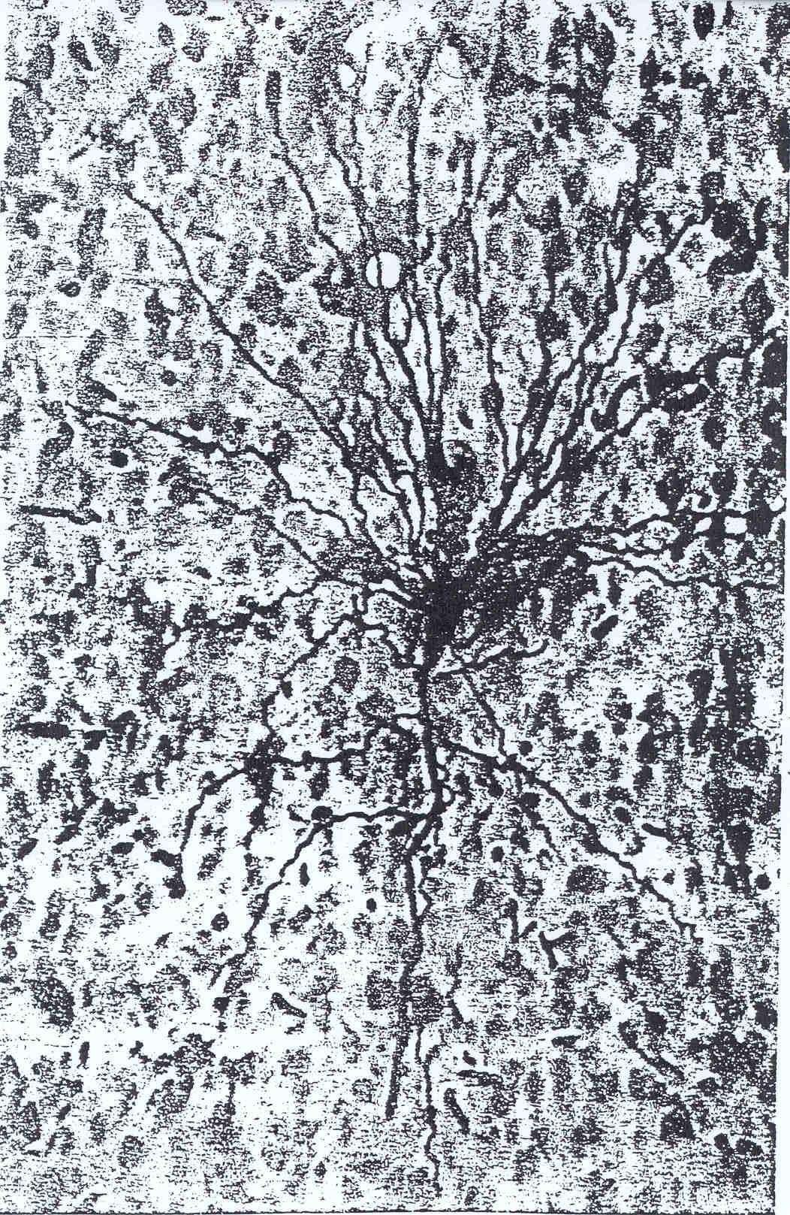
Notes:
Put up Mentimeter at beginning of class for them to sign on

Slide 2
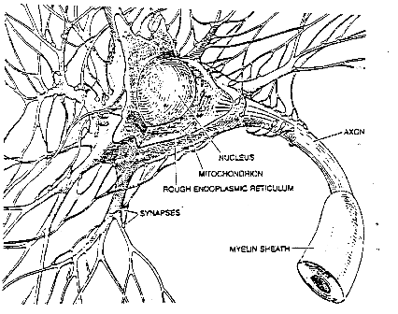
Basic Neuron

Slide 3
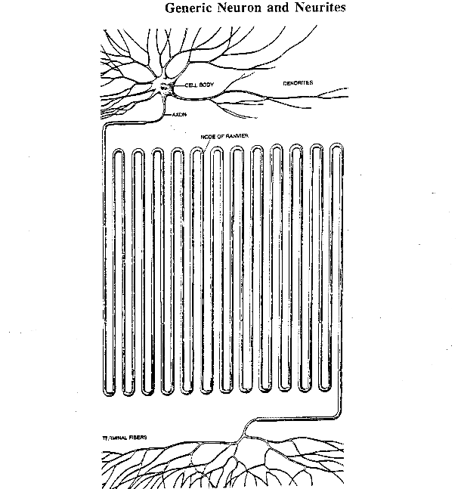
Expanded Neuron

Slide 4
Perceptron Learning Algorithm
First neural network learning model in the 1960’s
Frank Rosenblatt
Simple and limited (single layer model)
Basic concepts are similar for multi-layer models so this is a good learning tool
Still used in some current applications (large business problems, where intelligibility is needed, etc.)

Slide 5

Perceptron Node – Threshold Logic Unit
x₁
w₁
x₂
w₂
$$θ$$
z
x_{n}
w_{n}

Slide 6
Perceptron Node – Threshold Logic Unit
x₁
w₁
x₂
w₂
$$θ$$
z
x_{n}
w_{n}
Learn weights such that an objective function is maximized.
What objective function should we use?
What learning algorithm should we use?
Notes:
What parameters and objective function

Slide 7
Perceptron Learning Algorithm
x₁
.4
.1
z
x₂
-.2
x₁
x₂
t
.8
.3
1
.4
.1
0

Slide 8
First Training Instance
.8
.4
.1
z
=1
.3
-.2
net = .8*.4 + .3*-.2 = .26
x₁
x₂
t
.8
.3
1
.4
.1
0

Slide 9
Second Training Instance
.4
.4
.1
z
=1
.1
-.2
net = .4*.4 + .1*-.2 = .14
x₁
x₂
t
.8
.3
1
Δw_{i} =
(t - z)
∗ c
∗ x_{i}
.4
.1
0

Slide 10
Perceptron Rule Learning
Δw_{i} = c(t – z) x_{i}
Where w_{i} is the weight from input i to the perceptron node, c is the learning rate, t is the target for the current instance, z is the current output, and x_{i} is i^{th} input
Least perturbation principle
Only change weights if there is an error
small c rather than changing weights sufficient to make current pattern correct
Scale by x_{i}
Create a perceptron node with n inputs
Iteratively apply a pattern from the training set and apply the perceptron rule
Each iteration through the training set is an epoch
Continue training until total training set error ceases to improve
Perceptron Convergence Theorem: Guaranteed to find a solution in finite time if a solution exists
Notes:
Author uses y-t and thus negates the delta w

Slide 11
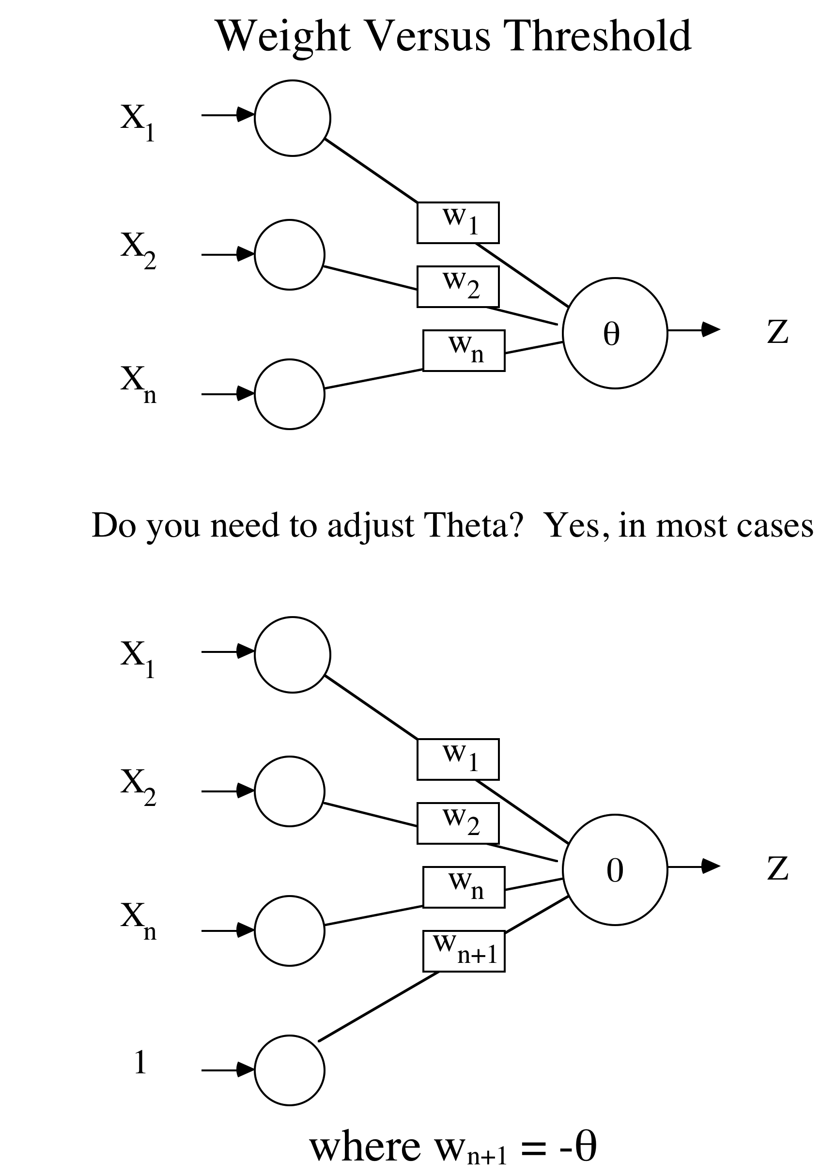

Slide 12
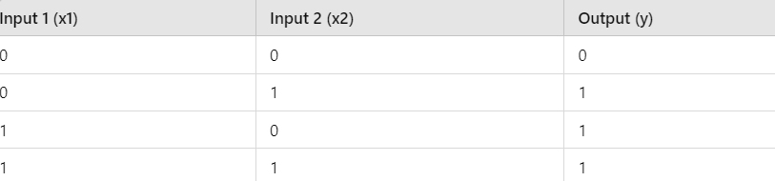
Problem: Binary Classification of OR Logic Gate
We want to build a model that classifies the output of an OR logic gate. The OR gate has two binary inputs (0 or 1) and one binary output. The output is 1 if at least one of the inputs is 1; otherwise, it is 0.
Here’s the truth table for the OR gate:
Notes:
Author uses -1 into bias, any real difference (back to being a threshold weight), but since starts random anyway, will make no difference, though the final weight will be negated by comparison

Slide 13
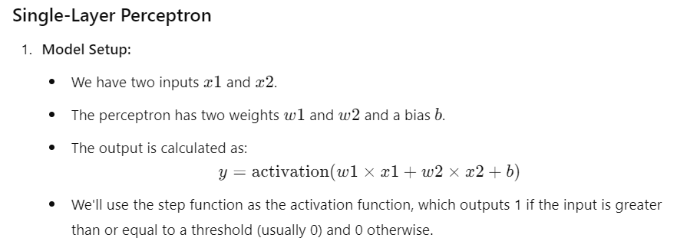
Single-Layer Perceptron

Slide 14
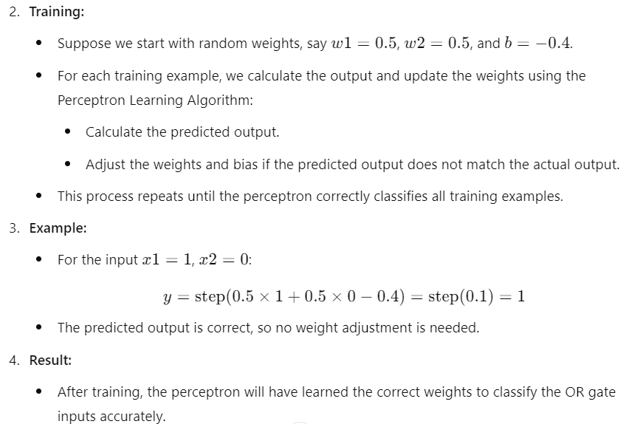

Slide 15
**Challenge Question** - Perceptron
Assume a 3 input perceptron plus bias (it outputs 1 if net > 0, else 0)
Assume a learning rate c of 1 and initial weights all 0: Δw_{i} = c(t – z) x_{i}
Training set 0 0 1 -> 0
1 1 1 -> 1
1 0 1 -> 1
0 1 1 -> 0
Pattern Target (t) Weight Vector (w_{i}) Net Output (z) ΔW
0 0 1 1 0 0 0 0 0 0 0 0 0 0 0
1 1 1 1 1 0 0 0 0 0 0 1 1 1 1
1 0 1 1 1 1 1 1 1
Once it converges the final weight vector will be
1 1 1 1
-1 0 1 0
0 0 0 0
1 0 0 0
None of the above

Slide 16
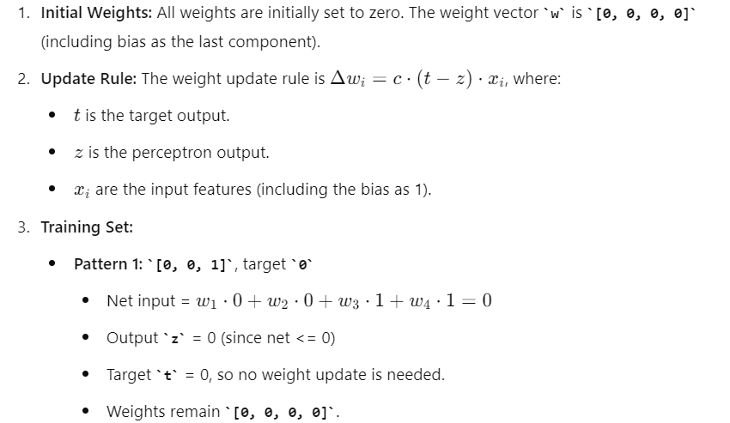

Slide 17
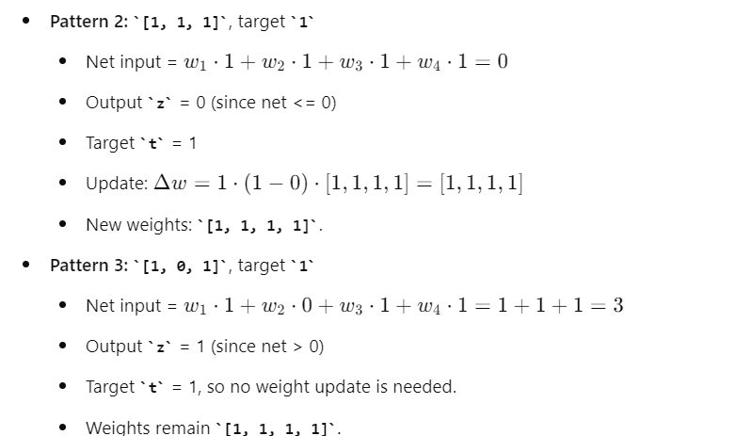

Slide 18
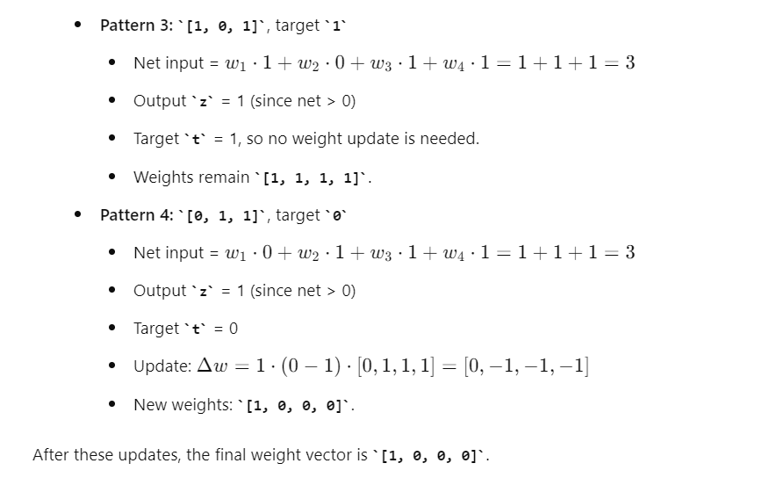

Slide 19
Example
Assume a 3 input perceptron plus bias (it outputs 1 if net > 0, else 0)
Assume a learning rate c of 1 and initial weights all 0: Δw_{i} = c(t – z) x_{i}
Training set 0 0 1 -> 0
1 1 1 -> 1
1 0 1 -> 1
0 1 1 -> 0
Pattern Target (t) Weight Vector (w_{i}) Net Output (z) ΔW
0 0 1 1 0 0 0 0 0 0 0 0 0 0 0
1 1 1 1 1 0 0 0 0 0 0 1 1 1 1
1 0 1 1 1 1 1 1 1 3 1 0 0 0 0
0 1 1 1 0 1 1 1 1

Slide 20
Example
Assume a 3 input perceptron plus bias (it outputs 1 if net > 0, else 0)
Assume a learning rate c of 1 and initial weights all 0: Δw_{i} = c(t – z) x_{i}
Training set 0 0 1 -> 0
1 1 1 -> 1
1 0 1 -> 1
0 1 1 -> 0
Pattern Target (t) Weight Vector (w_{i}) Net Output (z) ΔW
0 0 1 1 0 0 0 0 0 0 0 0 0 0 0
1 1 1 1 1 0 0 0 0 0 0 1 1 1 1
1 0 1 1 1 1 1 1 1 3 1 0 0 0 0
0 1 1 1 0 1 1 1 1 3 1 0 -1 -1 -1
0 0 1 1 0 1 0 0 0

Slide 21
Example
Assume a 3 input perceptron plus bias (it outputs 1 if net > 0, else 0)
Assume a learning rate c of 1 and initial weights all 0: Δw_{i} = c(t – z) x_{i}
Training set 0 0 1 -> 0
1 1 1 -> 1
1 0 1 -> 1
0 1 1 -> 0
Pattern Target (t) Weight Vector (w_{i}) Net Output (z) ΔW
0 0 1 1 0 0 0 0 0 0 0 0 0 0 0
1 1 1 1 1 0 0 0 0 0 0 1 1 1 1
1 0 1 1 1 1 1 1 1 3 1 0 0 0 0
0 1 1 1 0 1 1 1 1 3 1 0 -1 -1 -1
0 0 1 1 0 1 0 0 0 0 0 0 0 0 0
1 1 1 1 1 1 0 0 0 1 1 0 0 0 0
1 0 1 1 1 1 0 0 0 1 1 0 0 0 0
0 1 1 1 0 1 0 0 0 0 0 0 0 0 0
Notes:
Note it is the relative weight values which make the difference. If we multiply all final weights by a constant ( e.g. ,1) we still get the same results. For perceptron same as if the initial learning rate had been .1,
How would it generalize to novel. Show examples

Slide 22
Perceptron Homework
Assume a 3 input perceptron plus bias (it outputs 1 if net > 0, else 0)
Assume a learning rate c of 1 and initial weights all 1: Δw_{i} = c(t – z) x_{i}
Show weights after each pattern for just one epoch
Training set 1 0 1 -> 0
1 .5 0 -> 0
1 -.4 1 -> 1
0 1 .5 -> 1
Pattern Target (t) Weight Vector (w_{i}) Net Output (z) ΔW
1 1 1 1

Slide 23
Training Sets and Noise
Assume a Probability of Error at each input and output value each time a pattern is trained on
0 0 1 0 1 1 0 0 1 1 0 -> 0 1 1 0
i.e. P(error) = .05
Or a probability that the algorithm is applied wrong (opposite) occasionally
Averages out over learning

Slide 24
Linear Separability
Notes:
How many lines?

Slide 25
Linear Separability and Generalization
When is data noise vs. a legitimate exception

Slide 26
Limited Functionality of Hyperplane

Slide 27
How to Handle Multi-Class Output
This is an issue with learning models which only support binary classification (perceptron, SVM, etc.)
Create 1 perceptron for each output class, where the training set considers all other classes to be negative examples (one vs the rest)
Run all perceptrons on novel data and set the output to the class of the perceptron which outputs high
If there is a tie, choose the perceptron with the highest net value
Another approach: Create 1 perceptron for each pair of output classes, where the training set only contains examples from the 2 classes (one vs one)
Run all perceptrons on novel data and set the output to be the class with the most wins (votes) from the perceptrons
In case of a tie, use the net values to decide
Number of models grows by the square of the output classes
Notes:
Use next slide (Iris) as example
Skip second approach

Slide 28
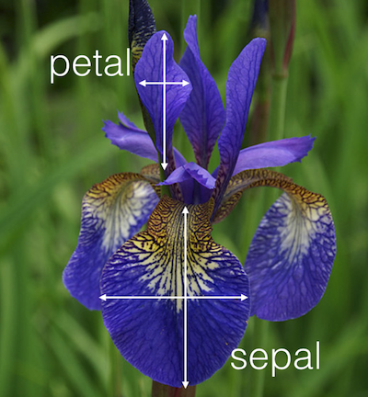
UC Irvine Machine Learning Data Base Iris Data Set
4.8,3.0,1.4,0.3, Iris-setosa
5.1,3.8,1.6,0.2, Iris-setosa
4.6,3.2,1.4,0.2, Iris-setosa
5.3,3.7,1.5,0.2, Iris-setosa
5.0,3.3,1.4,0.2, Iris-setosa
7.0,3.2,4.7,1.4, Iris-versicolor
6.4,3.2,4.5,1.5, Iris-versicolor
6.9,3.1,4.9,1.5, Iris-versicolor
5.5,2.3,4.0,1.3, Iris-versicolor
6.5,2.8,4.6,1.5, Iris-versicolor
6.0,2.2,5.0,1.5, Iris-viginica
6.9,3.2,5.7,2.3, Iris-viginica
5.6,2.8,4.9,2.0, Iris-viginica
7.7,2.8,6.7,2.0, Iris-viginica
6.3,2.7,4.9,1.8, Iris-viginica

Slide 29
Objective Functions: Accuracy/Error
How do we judge the quality of a particular model (e.g. Perceptron with a particular setting of weights)
Consider how accurate the model is on the data set
Classification accuracy = # Correct/Total instances
Classification error = # Misclassified/Total instances (= 1 – acc)
Usually minimize a Loss function (aka cost, error)
For real valued outputs and/or targets
Pattern error = Target – output: Errors could cancel each other
Σ|t_{j} – z_{j}| (L1 loss), where j indexes all outputs in the pattern
Common approach is Squared Error = Σ(t_{j} – z_{j})² (L2 loss)
Total sum squared error = Σ pattern squared errors = Σ Σ (t_{ij} – z_{ij})² where i indexes all the patterns in training set
For nominal data, pattern error is typically 1 for a mismatch and 0 for a match
For nominal (including binary) output and targets, L!, L2, and classification error are equivalent
Notes:
L2 some mathematical advantages with derivative, etc.
L2 increases effect of outliers
Usually won't subscript T and Z and assume they are vectors

Slide 30
Mean Squared Error
Mean Squared Error (MSE) – SSE/n where n is the number of instances in the data set
This can be nice because it normalizes the error for data sets of different sizes
MSE is the average squared error per pattern
Root Mean Squared Error (RMSE) – is the square root of the MSE
This puts the error value back into the same units as the features and can thus be more intuitive
Since we squared the error on the SSE
RMSE is the average distance (error) of targets from the outputs in the same scale as the features
Note RMSE is the root of the total data set MSE, and NOT the sum of the root of each individual pattern MSE

Slide 31
**Challenge Question** - Error
Given the following data set, what is the L1 (Σ|t_{i} – z_{i}|), SSE (L2) (Σ(t_{i} – z_{i})²), MSE, and RMSE error for the entire data set?
x | y | Output | Target | Data Set
2 | -3 | 1 | 1
0 | 1 | 0 | 1
.5 | .6 | .8 | .2
L1 |  |  |  | ?
SSE |  |  |  | ?
MSE |  |  |  | ?
RMSE |  |  |  | ?
.4 1 1 1
1.6 2.36 1 1
.4 .64 .21 0.453
1.6 1.36 .67 .82
None of the above

Slide 32
**Challenge Question** - Error
Given the following data set, what is the L1 (Σ|t_{i} – z_{i}|), SSE (L2) (Σ(t_{i} – z_{i})²), MSE, and RMSE error for the entire data set?
x | y | Output | Target | Data Set
2 | -3 | 1 | 1
0 | 1 | 0 | 1
.5 | .6 | .8 | .2
L1 |  |  |  | 1.6
SSE |  |  |  | 1.36
MSE |  |  |  | 1.36/3 = .453
RMSE |  |  |  | .45^.5 = .67
.4 1 1 1
1.6 2.36 1 1
.4 .64 .21 0.453
1.6 1.36 .67 .82
None of the above
Notes:
Note RMSE is MSE^.5 and not sum of the root of each individual pattern MSE

Slide 33
Error Values Homework
Given the following data set, what is the L1, SSE (L2), MSE, and RMSE error of Output1, Output2, and the entire data set? Fill in cells that have a ?.
Notes: For instance 1 the L1 pattern error is 1 + .6 = 1.6 and the SSE pattern error is 1 + .16 = 1.16. The Data Set L1 and SSE errors will just be the sum of each of the pattern errors.
Instance | x | y | Output1 | Target1 | Output2 | Target 2 | Data Set
1 | -1 | -1 | 0 | 1 | .6 | 1.0
2 | -1 | 1 | 1 | 1 | -.3 | 0
3 | 1 | -1 | 1 | 0 | 1.2 | .5
4 | 1 | 1 | 0 | 0 | 0 | -.2
L1 |  |  | ? |  | ? |  | ?
SSE |  |  | ? |  | ? |  | ?
MSE |  |  | ? |  | ? |  | ?
RMSE |  |  | ? |  | ? |  | ?

Slide 34
Gradient Descent Learning: Minimize (Maximize) the Objective Function
Error Landscape
Total SSE:
Sum Squared
Error
Σ (t – z)²
0
Weight Values
Notes:
How could you create such a graph – Sample, too many weight settings to completely fill in in general, but the abstract notion is important
If could do the entire graph we would just pick the minimum point

Slide 35
Deriving a Gradient Descent Learning Algorithm
Goal is to decrease overall error (or other loss function) each time a weight is changed
Total Sum Squared error one possible loss function E: Σ (t – z)²
Seek a weight changing algorithm such that is negative
If a formula can be found then we have a gradient descent learning algorithm
Delta rule is a variant of the perceptron rule which gives a gradient descent learning algorithm with perceptron nodes

Slide 36
Delta rule algorithm
Delta rule uses (target - net) before the net value goes through the threshold in the learning rule to decide weight update
Weights are updated even when the output would be correct
Because this model is single layer and because of the SSE objective function, the error surface is guaranteed to be parabolic with only one minima
Learning rate
If learning rate is too large can jump around global minimum
If too small, will get to minimum, but will take a longer time
Can decrease learning rate over time to give higher speed and still attain the global minimum (although exact minimum is still just for training set and thus…)
Notes:
Still uses threshold logic (perceptron) node

Slide 37
Batch vs Stochastic Update
To get the true gradient with the delta rule, we need to sum errors over the entire training set and only update weights at the end of each epoch
Batch (gradient) vs stochastic (on-line, incremental)
SGD (Stochastic Gradient Descent)
With the stochastic delta rule algorithm, you update after every pattern, just like with the perceptron algorithm (even though that means each change may not be along the true gradient)
Stochastic is more efficient and best to use in almost all cases, though not all have figured it out yet
We’ll talk about this in more detail when we get to Backpropagation

Slide 38
Perceptron rule vs Delta rule
Perceptron rule (target - thresholded output) guaranteed to converge to a separating hyperplane if the problem is linearly separable. Otherwise may not converge – could get in a cycle
Singe layer Delta rule guaranteed to have only one global minimum. Thus, it will converge to the best SSE solution whether the problem is linearly separable or not.
Could have a higher misclassification rate than with the perceptron rule and a less intuitive decision surface – we will discuss this later with regression where Delta rules is more appropriate
Stopping Criteria – For these models we stop when no longer making progress
When you have gone a few epochs with no significant improvement/change between epochs (including oscillations)

Slide 39
Linearly Separable Boolean Functions
d = # of dimensions (i.e. inputs)
Notes:
Show functions on board 2 and 3 d

Slide 40
Linearly Separable Boolean Functions
d = # of dimensions
P = 2^{d} = # of Patterns

Slide 41
Linearly Separable Boolean Functions
d = # of dimensions
P = 2^{d} = # of Patterns
2^{P} = 2^{2d}= # of Functions
n Total Functions Linearly Separable Functions
0 2 2
1 4 4
2 16 14
Notes:
Show functions on board

Slide 42
Linearly Separable Boolean Functions
d = # of dimensions
P = 2^{d} = # of Patterns
2^{P} = 2^{2d}= # of Functions
n Total Functions Linearly Separable Functions
0 2 2
1 4 4
2 16 14
3 256 104
4 65536 1882
5 4.3 × 10⁹ 94572
6 1.8 × 10¹⁹ 1.5 × 10⁷
7 3.4 × 10³⁸ 8.4 × 10⁹

Slide 43
Linear Models which are Non-Linear in the Input Space
So far we have used
We could preprocess the inputs in a non-linear way and do
To the perceptron algorithm it is the same but with more/different inputs. It still uses the same learning algorithm.
For example, for a problem with two inputs x and y (plus the bias), we could also add the inputs x², y², and x·y
The perceptron would just think it is a 5-dimensional task, and it is linear (5-d hyperplane) in those 5 dimensions
But what kind of decision surfaces would it allow for the original 2-d input space?
Notes:
Draw on board

Slide 44
Quadric Machine
All quadratic surfaces (2nd order)
ellipsoid
parabola
etc.
That significantly increases the number of problems that can be solved
Can we solve XOR with this setup?

Slide 45
Quadric Machine
All quadratic surfaces (2nd order)
ellipsoid
parabola
etc.
That significantly increases the number of problems that can be solved
But still many problem which are not quadrically separable
Could go to 3rd and higher order features, but number of possible features grows exponentially
Multi-layer neural networks will allow us to discover high-order features automatically from the input space

Slide 46
Simple Quadric Example
-3 -2 -1 0 1 2 3
f₁
What is the decision surface for a 1-d (1 input) problem?
Perceptron with just feature f₁ cannot separate the data
Could we add a transformed feature to our perceptron?
Notes:
What is the decision surface for a 1-d problem?

Slide 47
Simple Quadric Example
-3 -2 -1 0 1 2 3
f₁
Perceptron with just feature f₁ cannot separate the data
Could we add a transformed feature to our perceptron?
f₂ = f₁²
Notes:
Still just have f1 as main beginning feature, and we transform it.

Slide 48
Simple Quadric Example
f₂
-3 -2 -1 0 1 2 3
-3 -2 -1 0 1 2 3
f₁
f₁
Perceptron with just feature f₁ cannot separate the data
Could we add another feature to our perceptron f₂ = f₁²
Note could also think of this as just using feature f₁ but now allowing a quadric surface to divide the data
Note that f₁ not actually needed in this case
Notes:
Note didn’t need feature f1 in this case, just f1^2 (not all combinations needed). Perceptron would learn to ignore f1 and just use f2

Slide 49
Quadric Machine Homework
Assume a 2-input perceptron expanded to be a quadric (2nd order) perceptron, with 5 input weights (x, y, x·y, x², y²) and the bias weight
Assume it outputs 1 if net > 0, else 0
Assume a learning rate c of .5 and initial weights all 0
Δw_{i} = c(t – z) x_{i}
Show all weights after each pattern for one epoch with the following training set
x | y | Target
0 | .4 | 0
-.1 | 1.2 | 1
.5 | .8 | 0

